Slide 1


<Name>
<Date>

Slide 2

Outline
Executive Summary
Introduction
Methodology
Results
Conclusion
Appendix

Slide 3
Executive Summary
Summary of methodologies:
Data collection -> Data wrangling -> EDA -> Predictive Analysis
Summary of all results
Identified key success factors
Found correlations between payload and success
Built a predictive classification model with high accuracy

Slide 4
Introduction
This project, developed as part of the Data Science Capstone Course, involved working as a Data Scientist for a private space launch company.
The goal was to analyse historical SpaceX launch data to identify patterns, uncover insights, and develop predictive models to enhance the company's decision-making and launch success rate.

Slide 5

Section 1

Slide 6
Methodology
Executive Summary
Data collection: Collected SpaceX launch data using REST API and web scraping, converted JSON to DataFrame, and cleaned data by handling NULL values and filtering Falcon 1 launches.
Data Wrangling: Processed key attributes and converted landing outcomes into binary classes (0 = Fail, 1 = Success)..
Exploratory Data Analysis: Analyzed success rates by site and payload mass, identified correlations, and applied one-hot encoding.
Data Visualization: Built an interactive dashboard with Folium and Plotly Dash to visualize launch patterns and success factors.Perform predictive analysis using classification models
Predictive Modeling: Trained ML models (Logistic Regression, SVM, Decision Tree, KNN), optimized hyperparameters with Grid Search, and evaluated with a confusion matrix

Slide 7
Data Collection
Gathered SpaceX launch data using SpaceX REST API and web scraping (BeautifulSoup).
Converted JSON data to a DataFrame using json_normalize.
Cleaned data by filtering out Falcon 1 launches and handling NULL values using the mean.

Slide 8
Data Collection – SpaceX API
Present your data collection with SpaceX REST calls using key phrases and flowcharts
Data Collection - SpaceX API
Place your flowchart of SpaceX API calls here

Slide 9
Data Collection - Scraping
Present your web scraping process using key phrases and flowcharts
Data Collection - Scrapping
Place your flowchart of web scraping here

Slide 10
Data Wrangling
Processed key attributes: Flight Number, Date, Booster Version, Payload Mass, Launch Site, and Outcome.
Converted categorical landing outcomes to binary classes (0 = Fail, 1 = Success)
Data Wrangling

Slide 11
EDA with Data Visualization
Scatter Plot: To show the relationship between two numerical variables.
Bar Chart: To compare categories and highlight differences.
Line Plot: To display trends over time or continuous data.
EDA with Data Visualization

Slide 12
EDA with SQL
Unique Launch Sites
Launch Sites Starting with 'CCA'Total Payload Mass (NASA)
Average Payload Mass (F9 v1.1)
First Successful Ground Pad Landing
Successful Drone Ship Landings (4000-6000 kg)
Mission Outcome Count
Maximum Payload Mass
Failed Drone Ship Landings (2015)
Rank Landing Outcomes
EDA with SQL

Slide 13
Build an Interactive Map with Folium
Marker: Added to show the location of launche sites, the closest coastline, and the closest city with the distance labelled.
Line: Added to visually connect the launch site to the closest city and the closest coastline, highlighting the proximity.
Interactive Map with Folium

Slide 14
Build a Dashboard with Plotly Dash
Dropdown (Launch Site): Added to allow users to select a specific launch site or view data for all sites. Helps identify success rates across different sites.
Pie Chart: Added to visualize the proportion of successful versus failed launches for the selected site or all sites. Helps analyze the success rate of each site.
Range Slider (Payload): Added to filter data by payload range. Helps explore how payload mass affects launch success.
Scatter Plot: Added to display the relationship between payload mass and launch outcome, with color labels for different booster versions. Helps identify patterns and correlations between payload, booster version, and success rates.
Dashboard with Plotly Dash

Slide 15
Predictive Analysis (Classification)
Predictive Analysis

Slide 16
Results
Launch site with the highest success rate: KSC LC-39A
Payload mass range with highest success rate: Between 2,000 kg and 5,000 kg
Booster version with highest success rate: Falcon 9 Block 5
Predictive model accuracy: 85%

Slide 17

Section 2

Slide 18
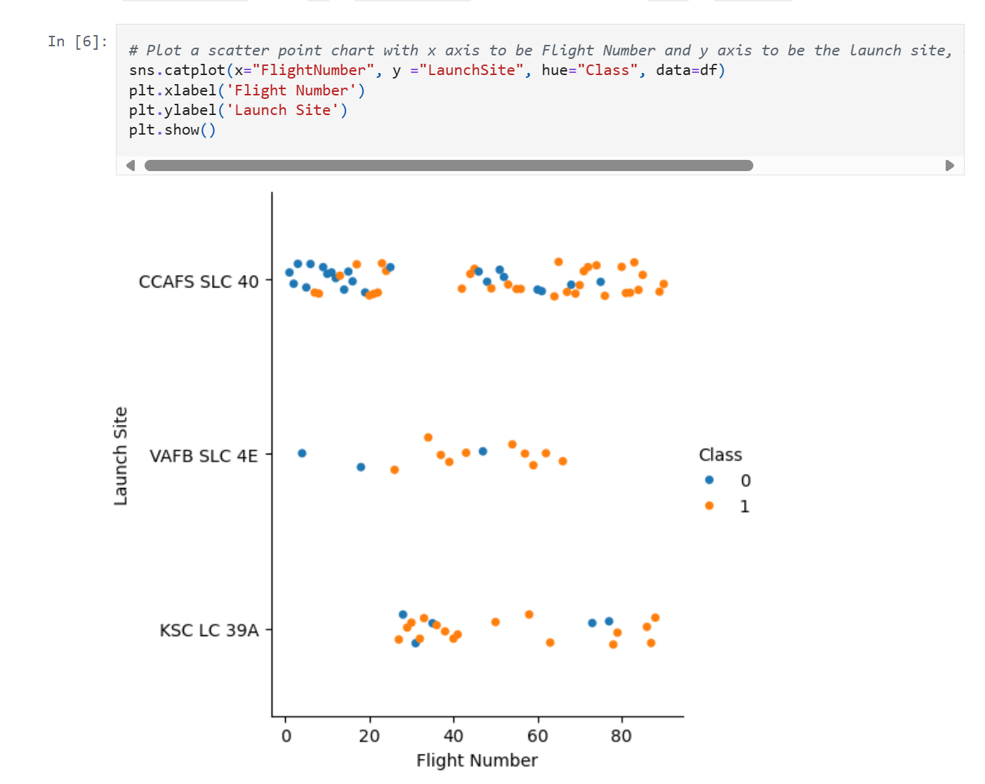
Flight Number vs. Launch Site
Launches with higher flight numbers are more likely to succeed. This presents a consistent improvement throughout SpaceX’s developing process

Slide 19
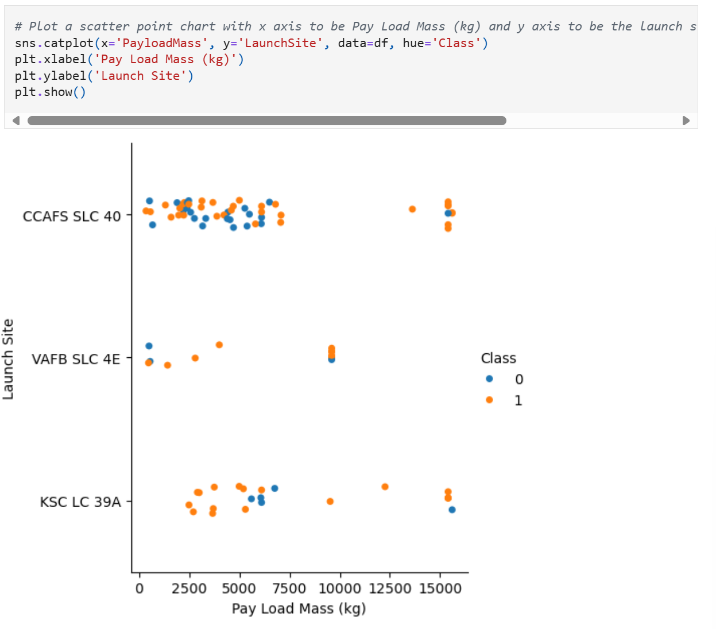
Payload vs. Launch Site
There is no rocket launched for payload mass greater than 10000kg
There is no observable correlation between payload, launch site and successful rate

Slide 20
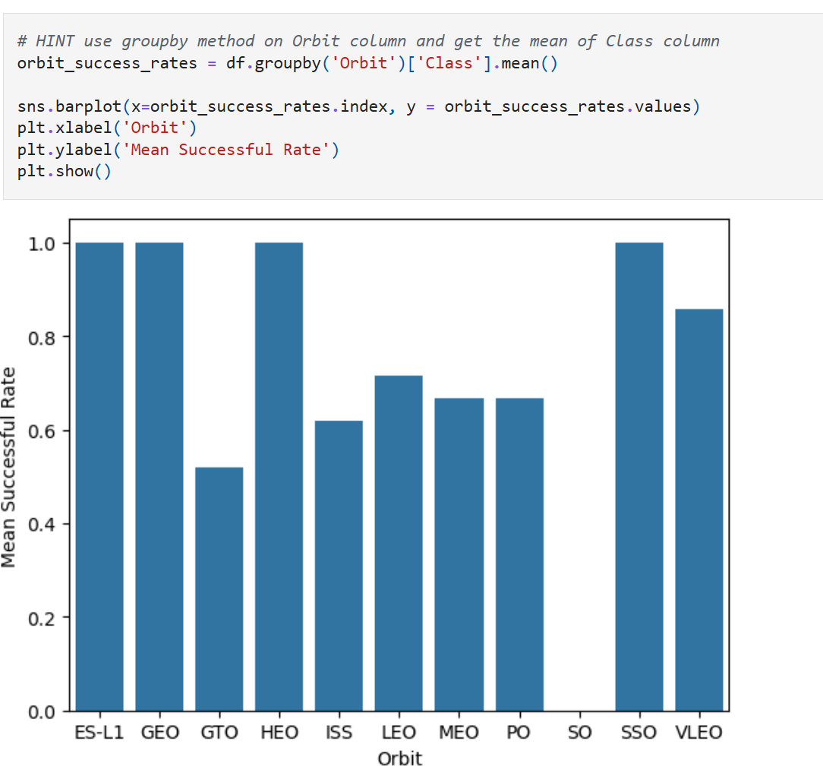
Success Rate vs. Orbit Type
ES-L1, GEO, HEO, SSO have the highest success rates (between 95%-100%)
GTO, ISS, LEO, MEO, and PO have lower success rates falling between 50%-70%
SO has the lowest success rate at 0%

Slide 21
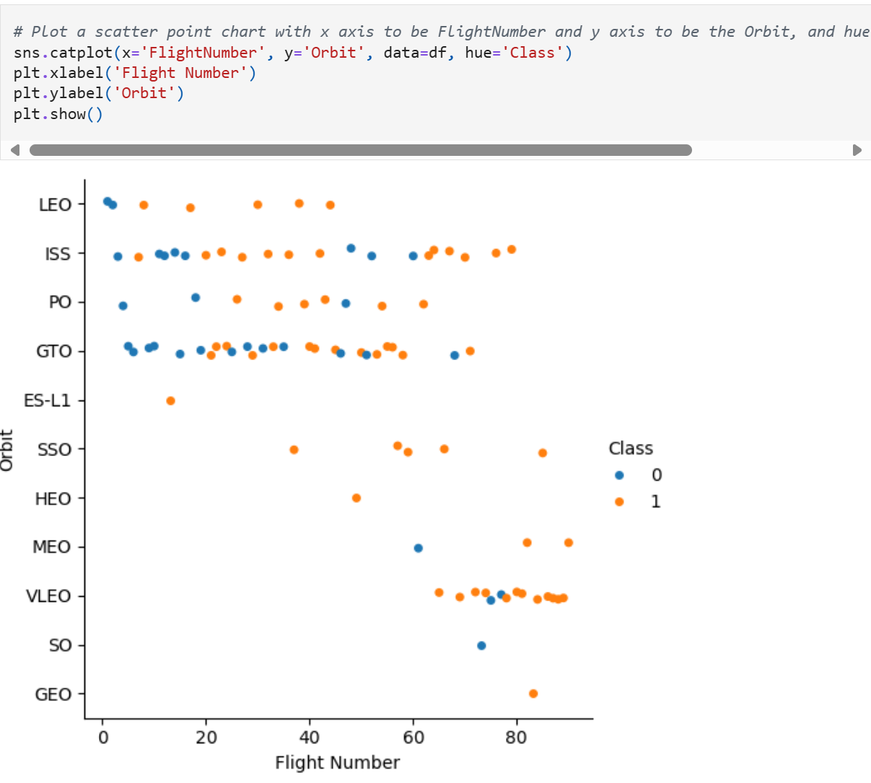
Flight Number vs. Orbit Type
It is observable that in the LEO orbit, success seems to be related to the number of flights.
Conversely, in the GTO orbit, there appears to be no relationship between flight number and success.

Slide 22
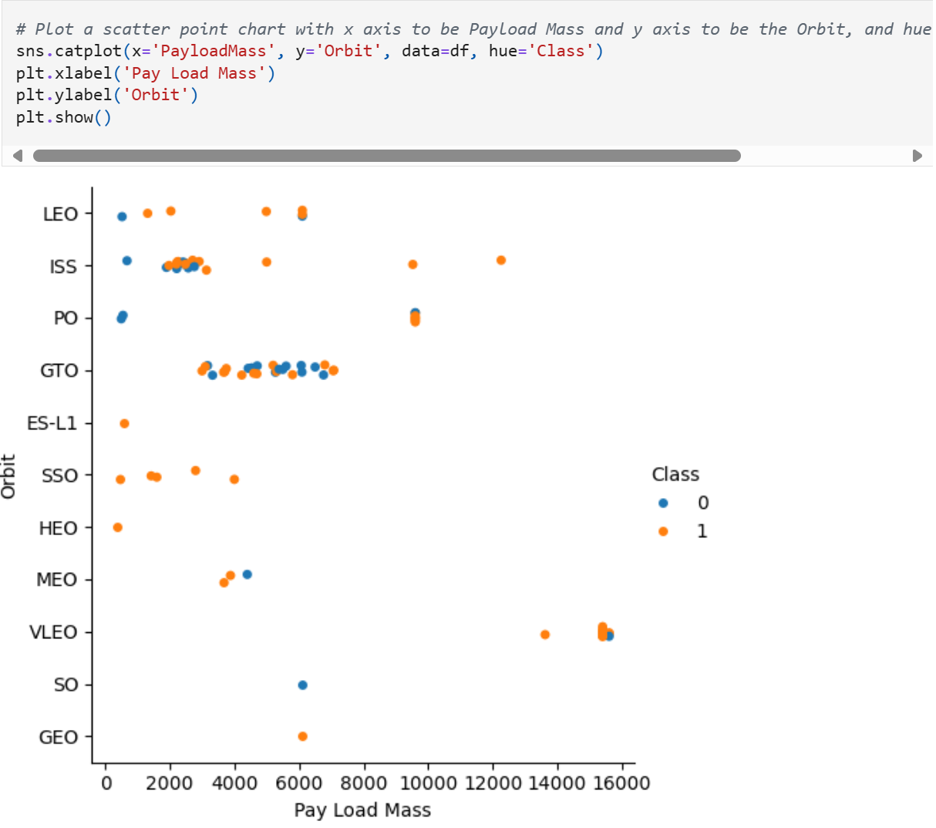
Payload
vs. Orbit Type
With heavy payloads the successful landing or positive landing rate are more for Polar,LEO and ISS.
However, for GTO, it's difficult to distinguish between successful and unsuccessful landings as both outcomes are present.

Slide 23
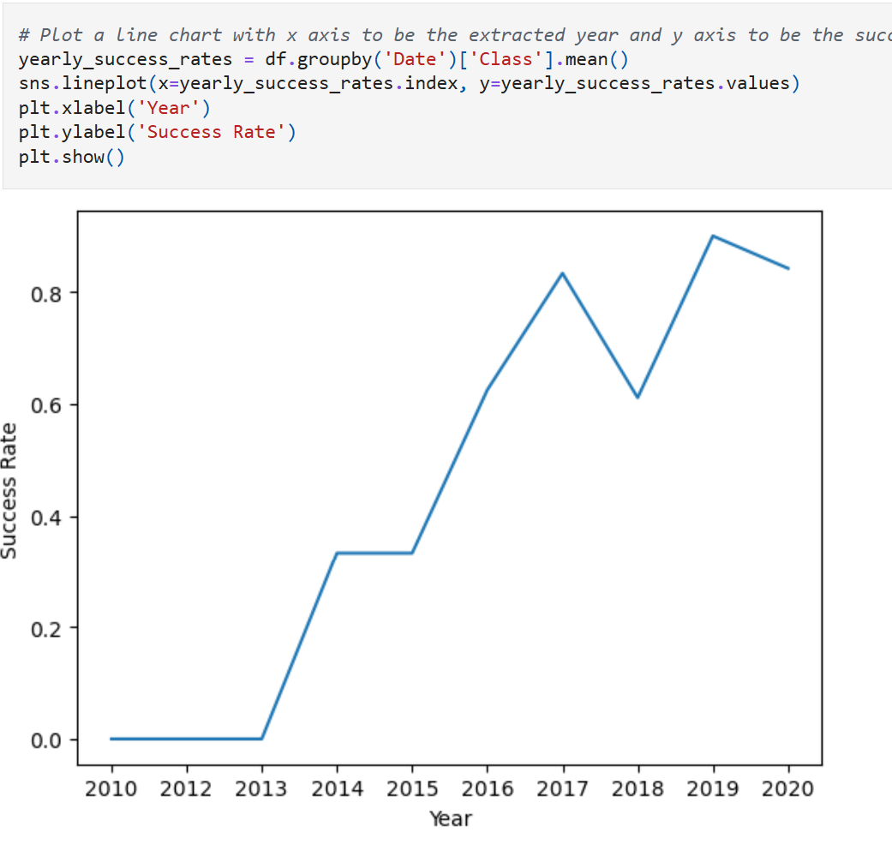
Launch Success Yearly Trend
Overall, the success rate increase over the period between 2010 and 2020

Slide 24
All Launch Site Names
All launch site names are:
Present your query result with a short explanation here
CCAFS LC-40
VAFB SLC-4E
KSC LC-39A
CCAFS SLC-40
%sql SELECT DISTINCT Launch_Site FROM SPACEXTABLE

Slide 25
Launch Site Names Begin with 'CCA'
Find 5 records whee launch sites begin with `CCA`
Present your query result with a short explanation here
Launch_Site
CCAFS LC-40
CCAFS LC-40
CCAFS LC-40
CCAFS LC-40
CCAFS LC-40

Slide 26
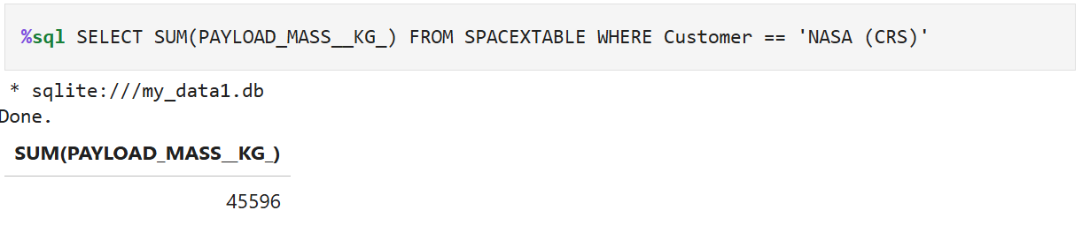
Total Payload Mass

Slide 27
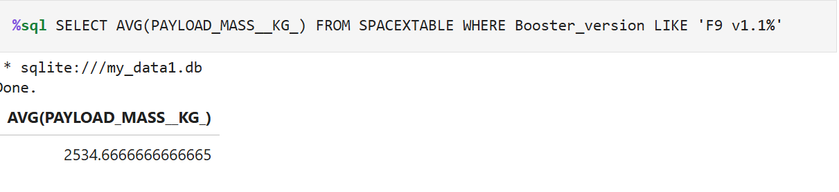
Average Payload Mass by F9 v1.1

Slide 28
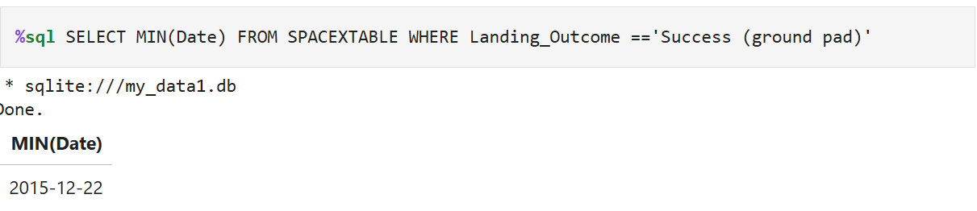
First Successful Ground Landing Date

Slide 29
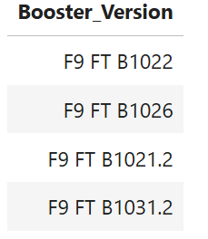
Successful Drone Ship Landing with Payload between 4000 and 6000
%sql SELECT DISTINCT Booster_Version FROM SPACEXTABLE
WHERE Landing_Outcome == 'Success (drone ship)' AND PAYLOAD_MASS__KG_ BETWEEN 4000 AND 6000

Slide 30
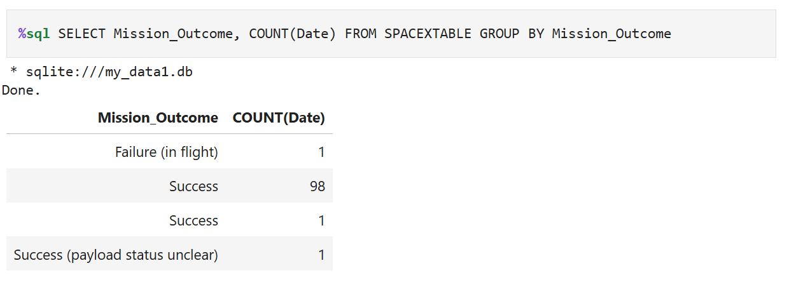
Total Number of Successful and Failure Mission Outcomes

Slide 31
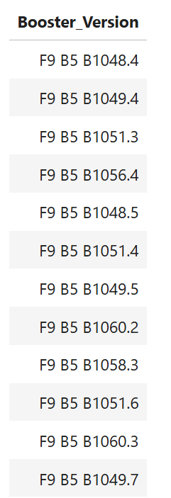
Boosters Carried Maximum Payload
%sql SELECT Booster_Version FROM SPACEXTABLE WHERE PAYLOAD_MASS__KG_ == (SELECT MAX(PAYLOAD_MASS__KG_) FROM SPACEXTABLE)

Slide 32
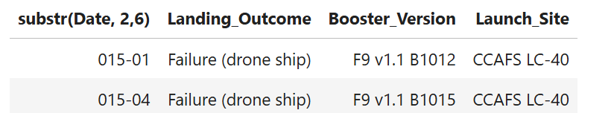
2015 Launch Records
%sql SELECT substr(Date, 2,6), Landing_Outcome, Booster_Version, Launch_Site FROM SPACEXTABLE
WHERE Landing_Outcome = 'Failure (drone ship)' AND substr(Date, 0,5) ='2015'

Slide 33
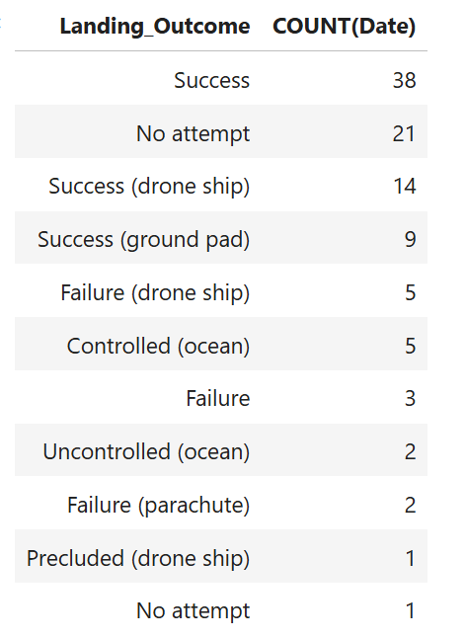
Rank Landing Outcomes Between 2010-06-04 and 2017-03-20
%sql SELECT Landing_Outcome, COUNT(Date) FROM SPACEXTABLE GROUP BY Landing_Outcome ORDER BY COUNT(DATE) DESC

Slide 34

Section 3

Slide 35
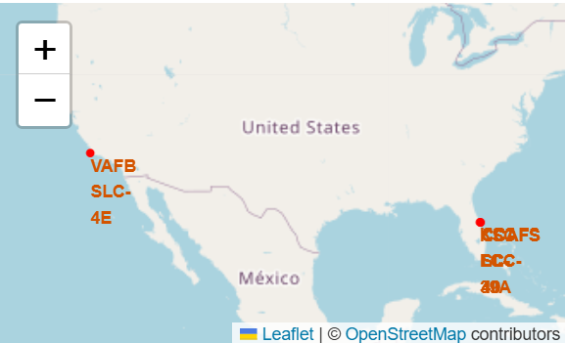
All Launch Sites

Slide 36
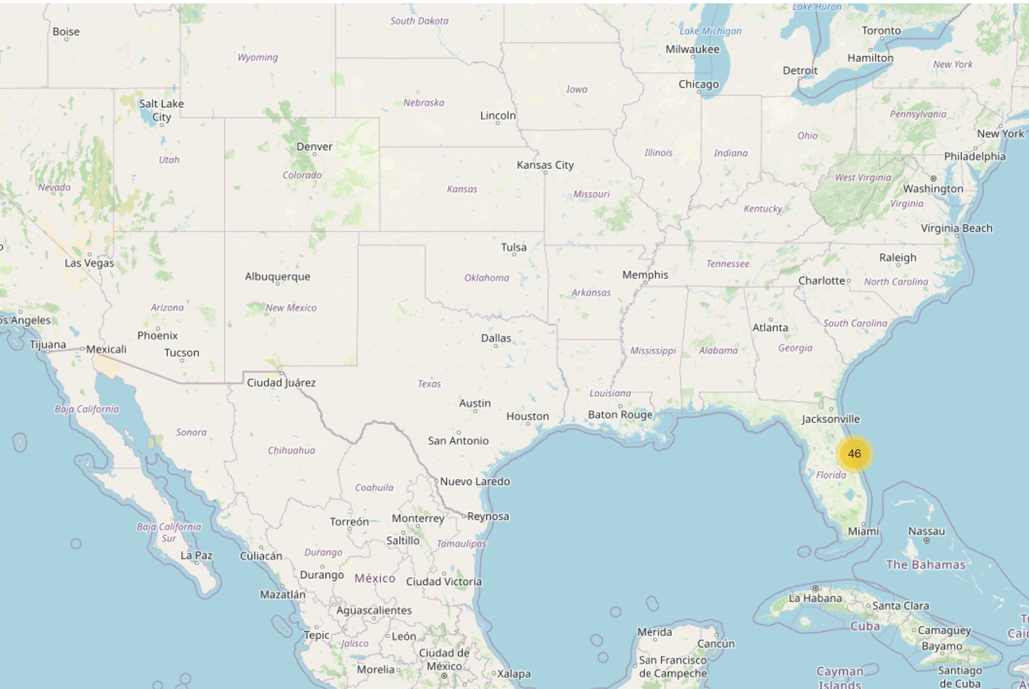
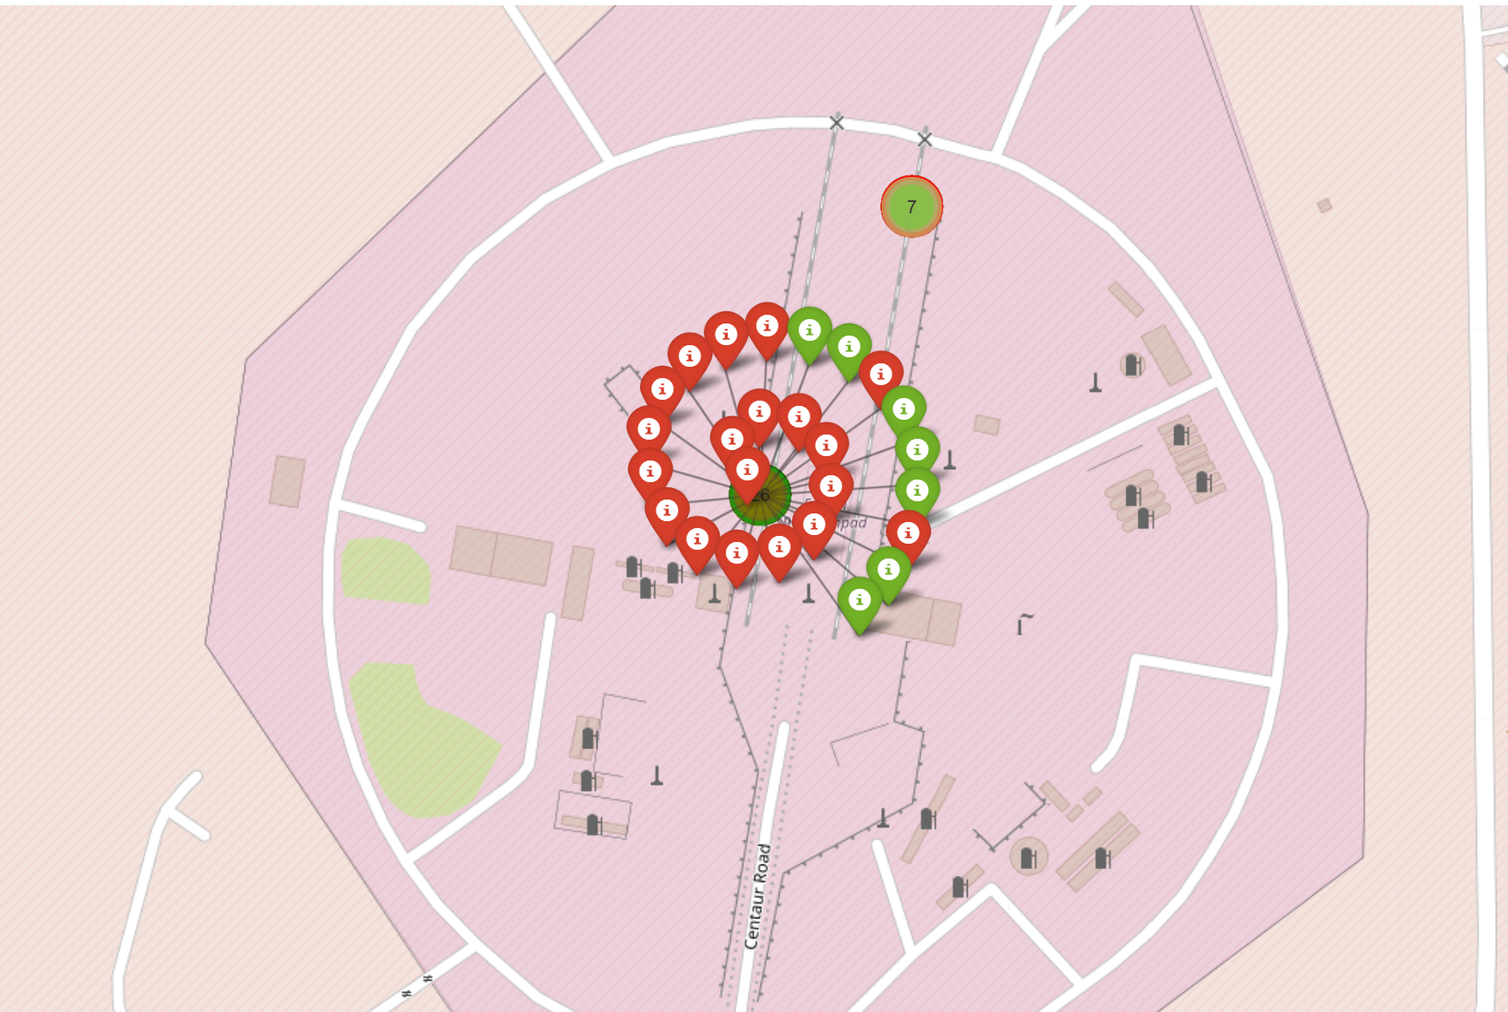
Launch Site Clusters

Slide 37
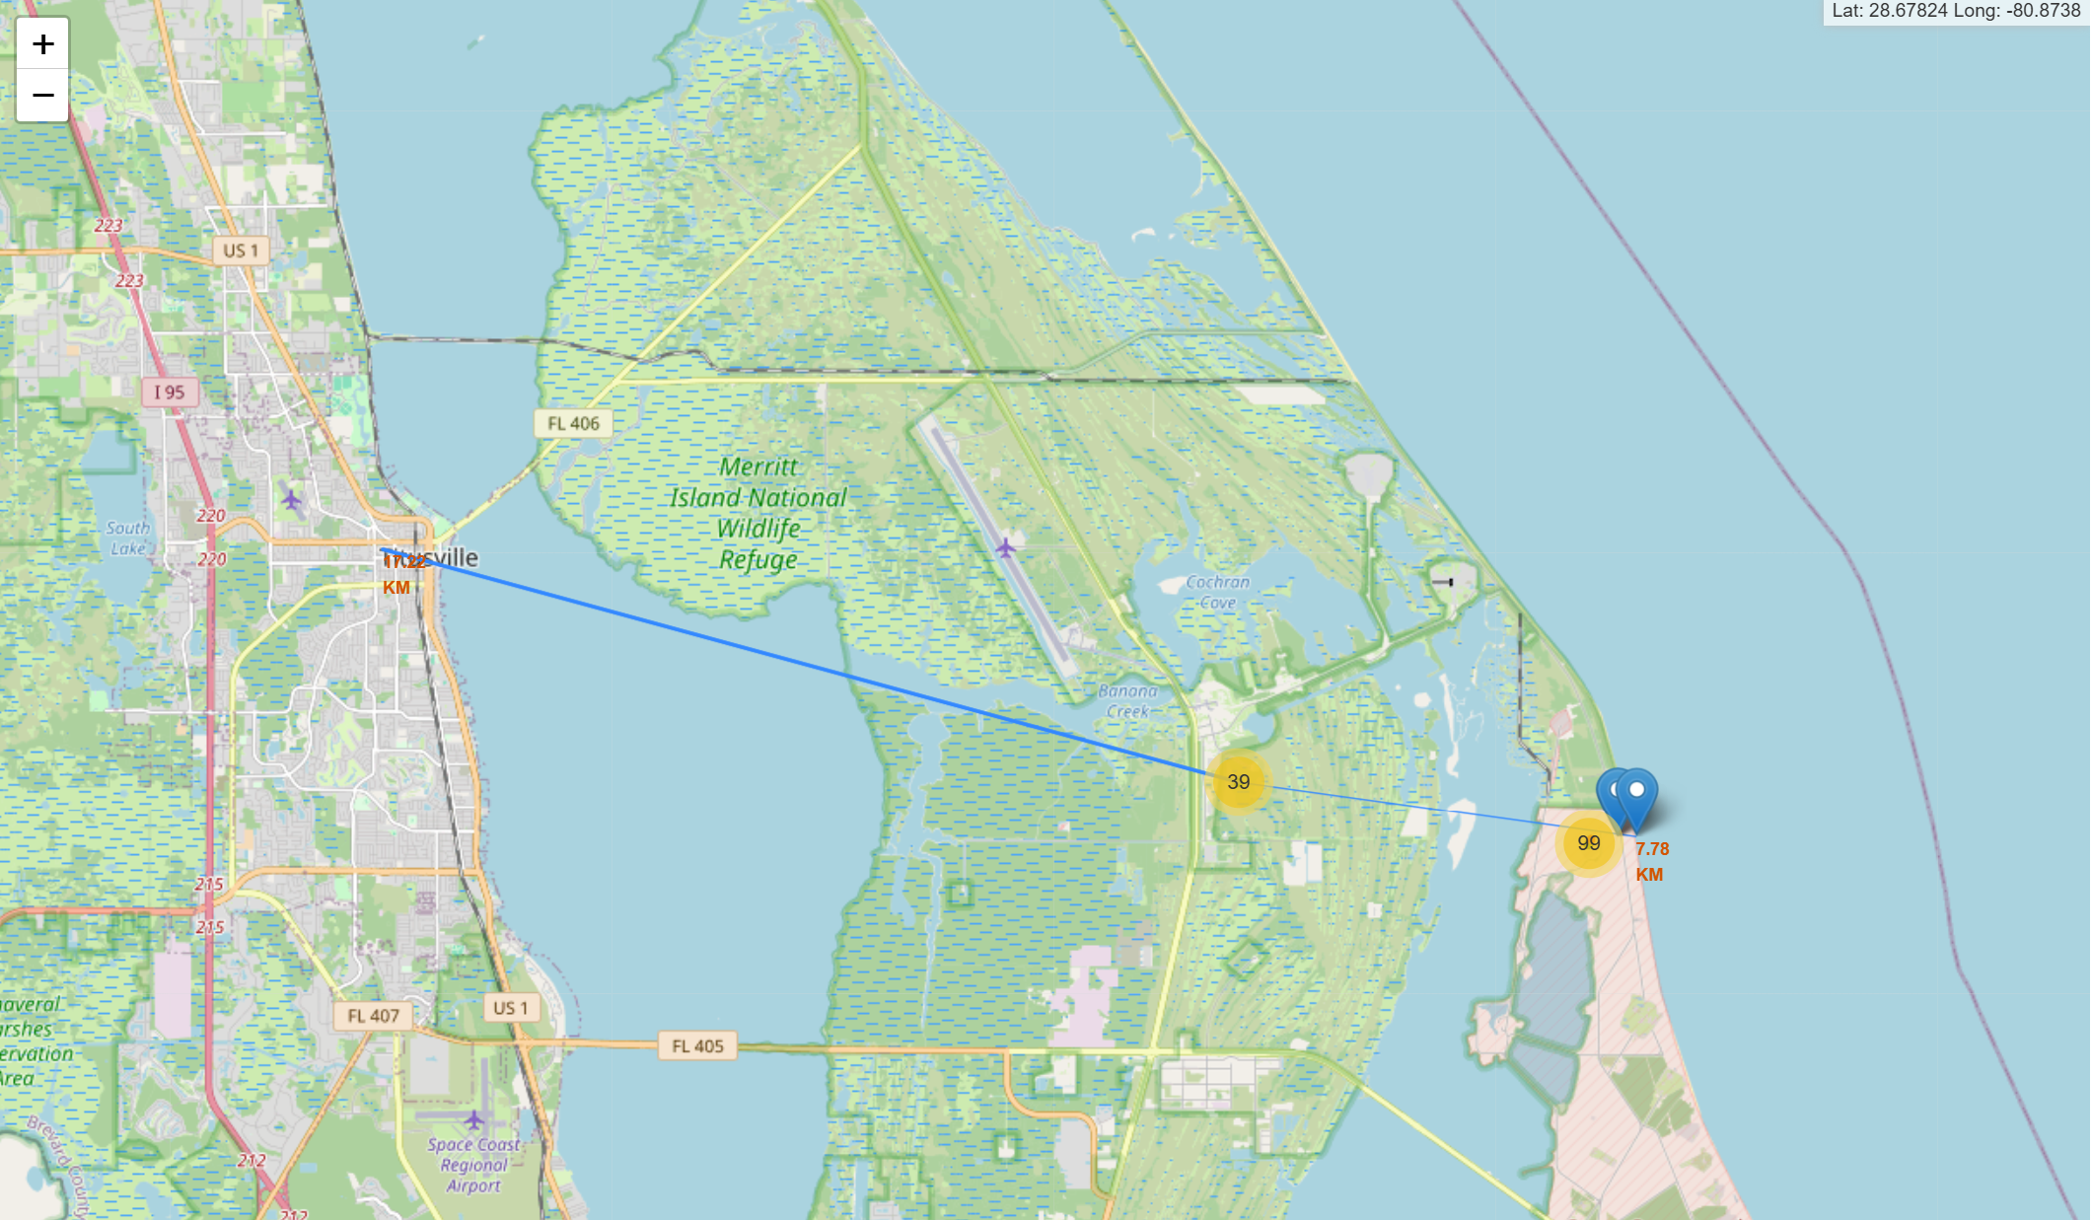
Distances

Slide 38

Section 4

Slide 39
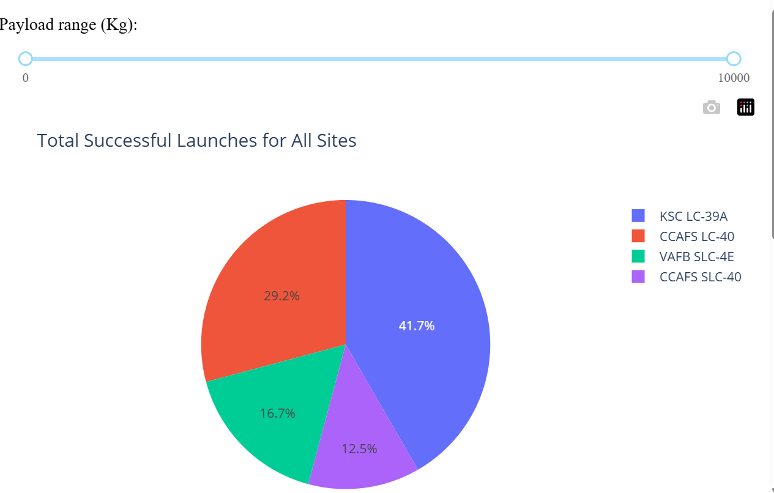
All Site Successful Launches

Slide 40
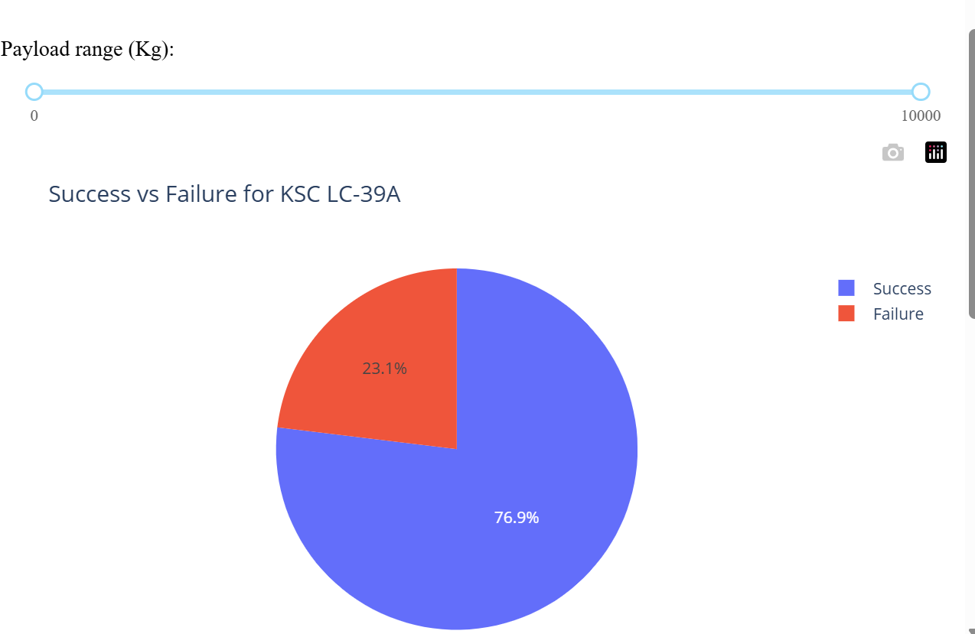
Highest Launch Success Ratio

Slide 41
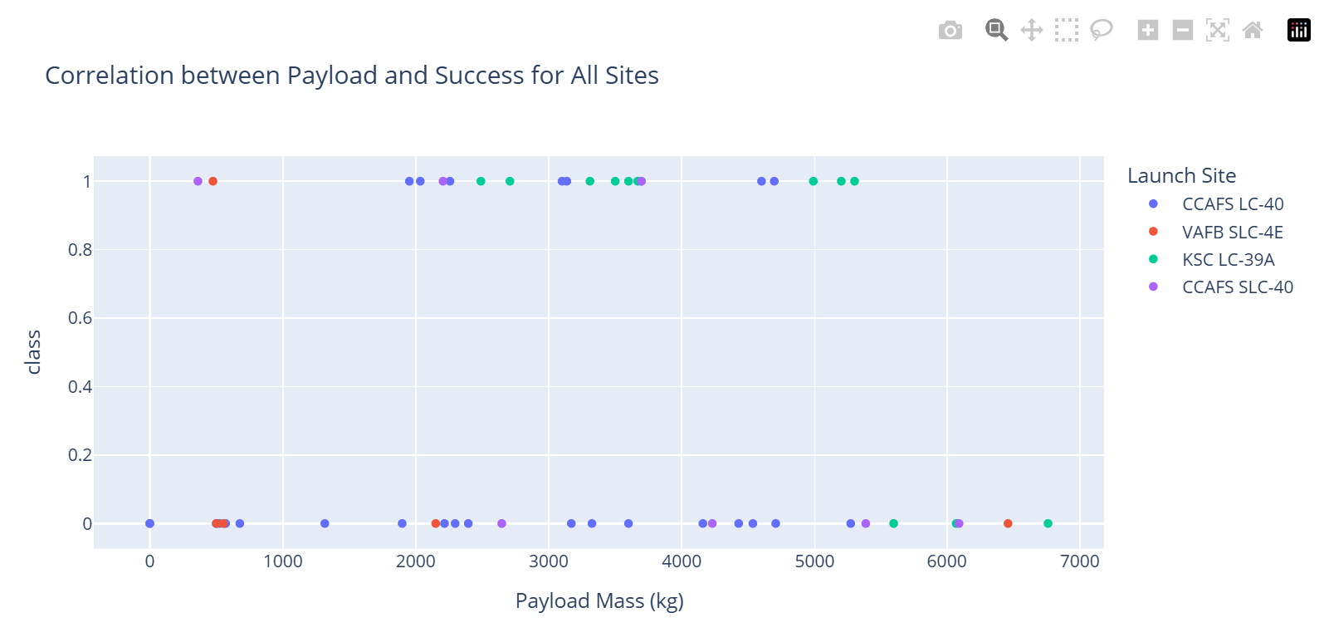
Payload vs. Launch Outcome (Payload between 0 and 7000)

Slide 42

Section 5

Slide 43
Classification Accuracy
Visualize the built model accuracy for all built classification models, in a bar chart
Find which model has the highest classification accuracy

Slide 44
Confusion Matrix
Show the confusion matrix of the best performing model with an explanation

Slide 45
Conclusions
In this project, I have
Performed exploratory data analysis (EDA) to identify patterns and trends in SpaceX launch data.
Applied feature engineering using one-hot encoding to prepare data for machine learning.
Developed an interactive Plotly Dash dashboard for real-time analysis of launch success rates by site and payload range.
Built and tuned predictive classification models using GridSearchCV and identify the best performer.
Evaluated the model using accuracy scores and a confusion matrix to identify the best-performing configuration.
Provided actionable insights to improve future SpaceX launch success rates.

Slide 46
Appendix
Include any relevant assets like Python code snippets, SQL queries, charts, Notebook outputs, or data sets that you may have created during this project

Slide 47


